Slide 1
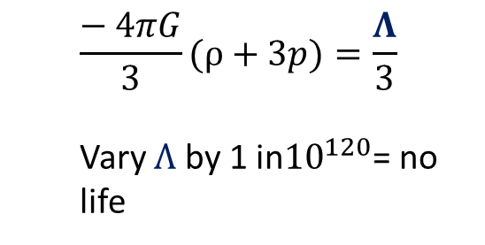
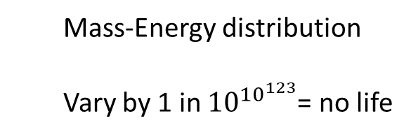
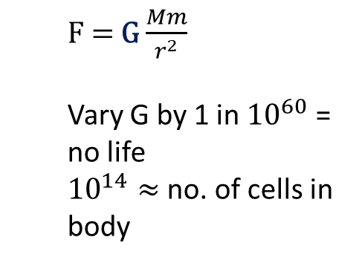
#15 Fine- Tuning of the Universe: The evidence for Design Participant # 15
Extremely narrow life permitting range.
Examples:
Explanations:
Necessity laws of nature are necessarily so
Chance Absurd improbability
Design The best candidate – super mind / God
References Burgess, C. and Moore, G. (2007). The standard model. Cambridge: Cambridge University Press. Barrow, J., Tipler, F. and Wheeler, J. (1996). The Anthropic Cosmological Principle. Oxford, New York: Oxford University Press.

